Slide 1
MPI & GRPC

Slide 2
MPI code for performing linear search operation for all the occurrences of a specific integer
value.
The code uses MPI library to search for a given integer value in an array of integers.
The program initializes MPI, reads an array of integers from a file, and broadcasts it to all nodes.
Then each node searches its portion of the array for the given integer value. If a node finds the integer, it sends a message to all other nodes, and the program terminates.
Further it includes options to customize the input file and the integer value to search for via command line parameters.

Slide 3
Implementation
You should run the MPI code on the Slurm cluster which you have configured in Assignment 1, and on your PC (for testing purposes)
To run the MPI code on the cluster, you need to first install required packages on all machines, including the head node. The same is when you want to run MPI on your own machine. You are suggested to install MPICH.
This program performs the search operation. We have an index file that contains a lot of integer values. The task of this program is to search for all the occurrences of a specific integer value.
./mpi_search_All data30000000.txt 30000000 16384
To run on a laptop/PC (e.g., with 4 cores): mpirun -np 4 ./mpi_search
Notes:
the program will perform a parallel search for the value 16,384 in the specified array. If the value is found, the program will notify the other processes, and you will see messages indicating the discovery in the output.

Slide 4
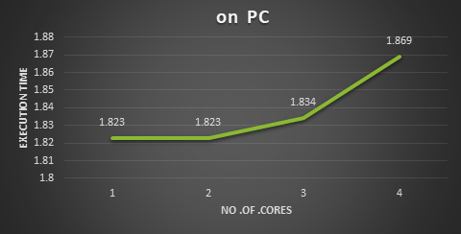
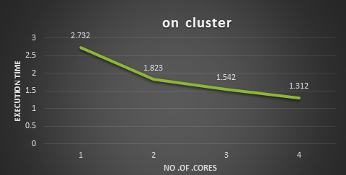
Evaluation

Slide 5
GRPC
gRPC is a robust rpc framework used to build fast scalable and fast APIs. It allows client and server applications to communicate transparently and develop connected systems using a protocol buffer.
The assignment mainly consists of client-server program that operates based on gRPC. The server’s purpose is to return number of times a given word appears in an index file and client’s role is to allow the user to remotely use the servers’ functionalities by passing the given word.
The server code was written in python while the client code was written in both python and node.js. The main objective here is to add a function to the client code written in node.js.

Slide 6
iMPLEMENTATION
The task is to develop a new function that returns the number of times the word ‘money’ appears in test file.
Keysearch.proto file: A query for the second function was added and return schema should be written.
Server.py code: On the server code, a new function(WhohasMinCount) should be written.
Client-node.js code: In the switch block a new case statement is included “WhohasMinCount” which triggers the function WhohasMinCount.

